Slide 1

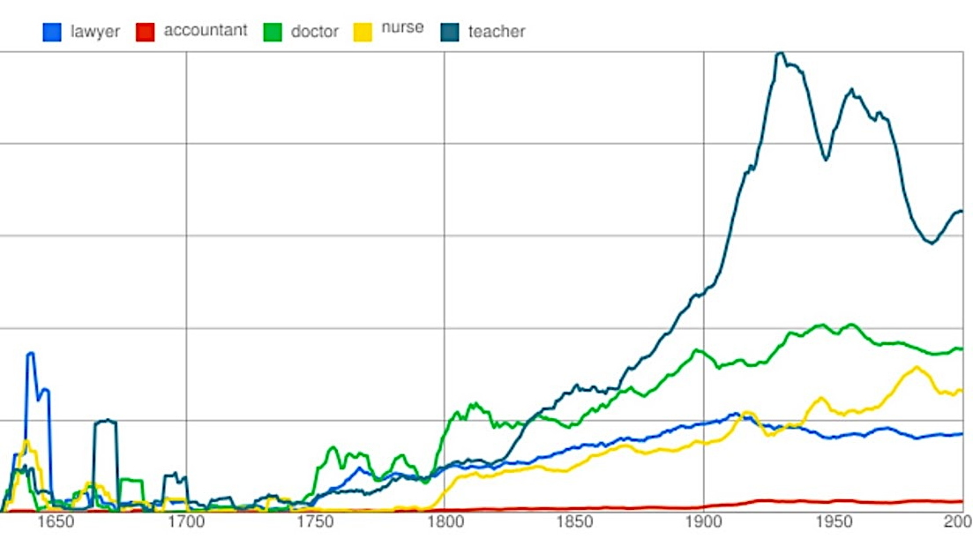

Culturomics
JB. Michel & al “Quantitative analysis of culture using millions of digitized books”, Science (2010)
http://www.ted.com/talks/what_we_learned_from_5_million_books.html
Notes:
Done by analyzing millions of books

Slide 2
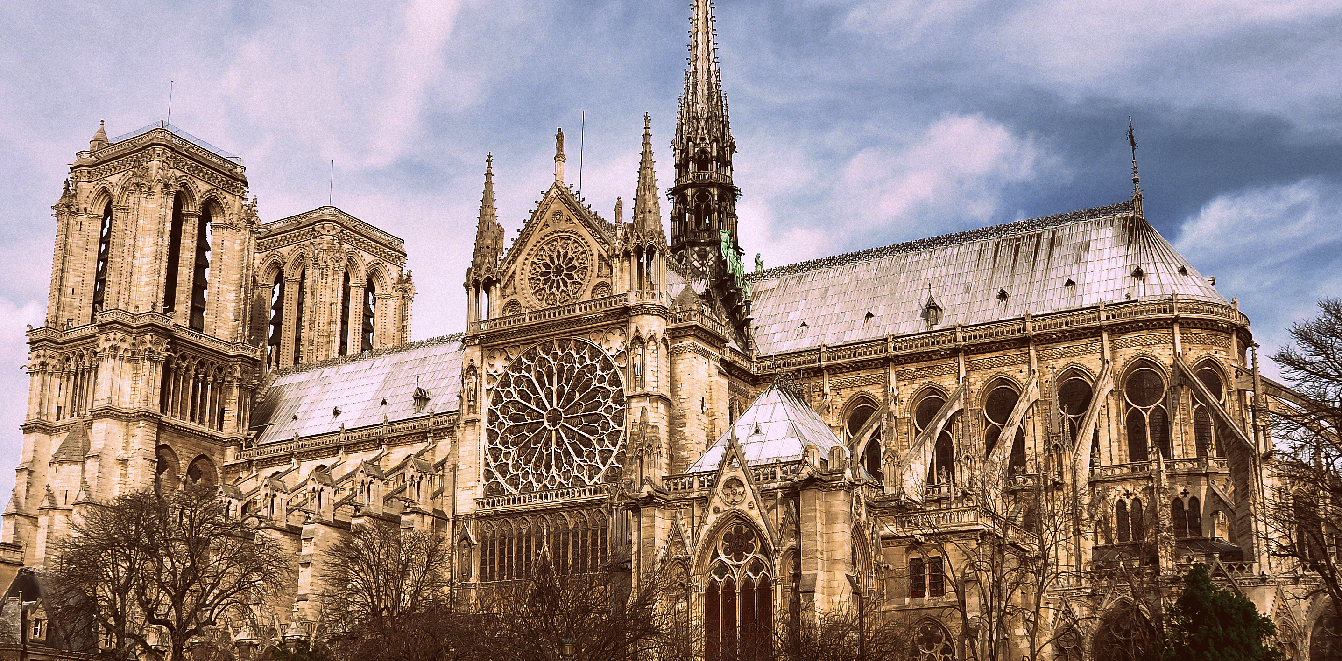
Question: How to study quantitatively the spatial and temporal evolution on cultural artifact from the physical world e.g. architectural elements?
Cathedral de Notre Dame - Paris

Slide 3
first.. where to find a large corpus like the million digitalized books from Google?

Slide 4
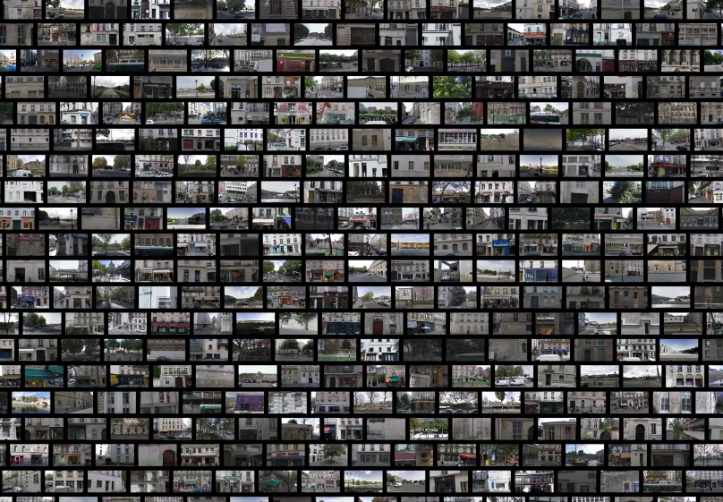
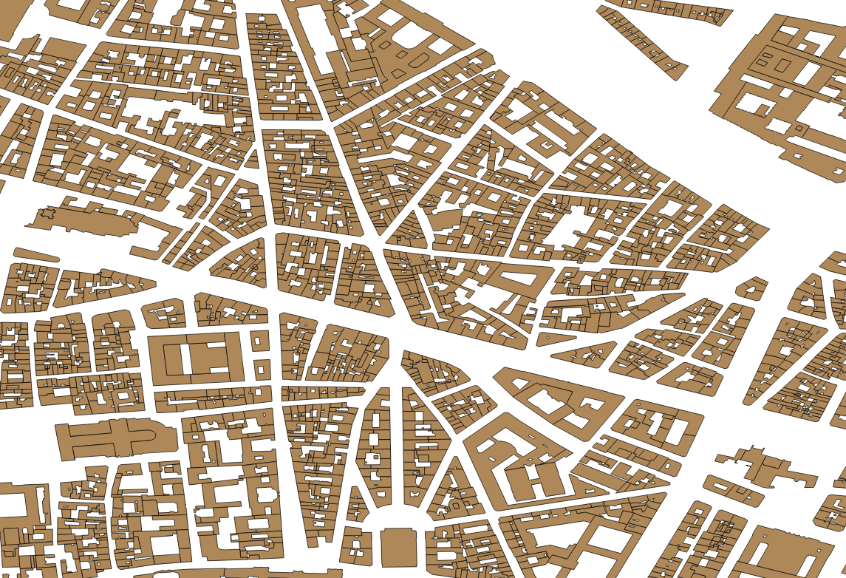
idea: combining
Large dataset of geolocated Google Street View images
digitalized cadaster data
+
“Quantitative analysis of culture using millions of digitized Books Streets” ?

Slide 5
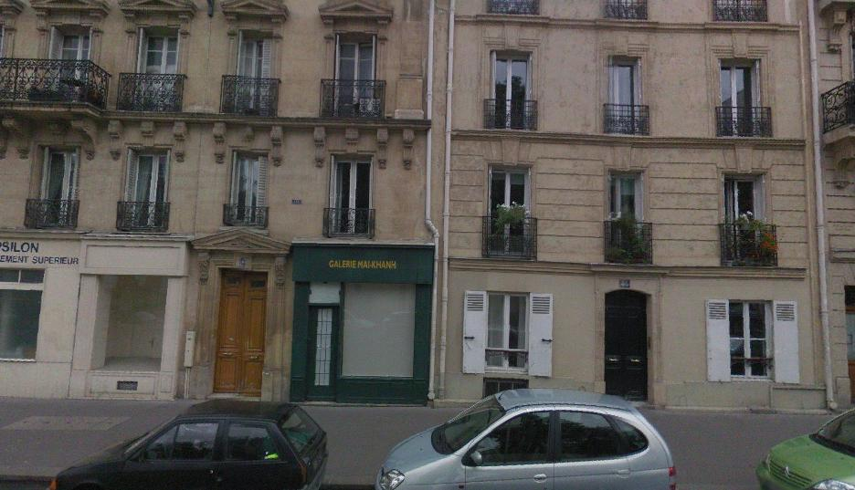
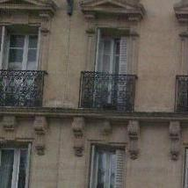
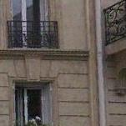
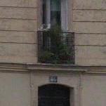
In a previous work [1] we were able to automatically extract visual elements in 5K geolocated GSV images

Slide 6
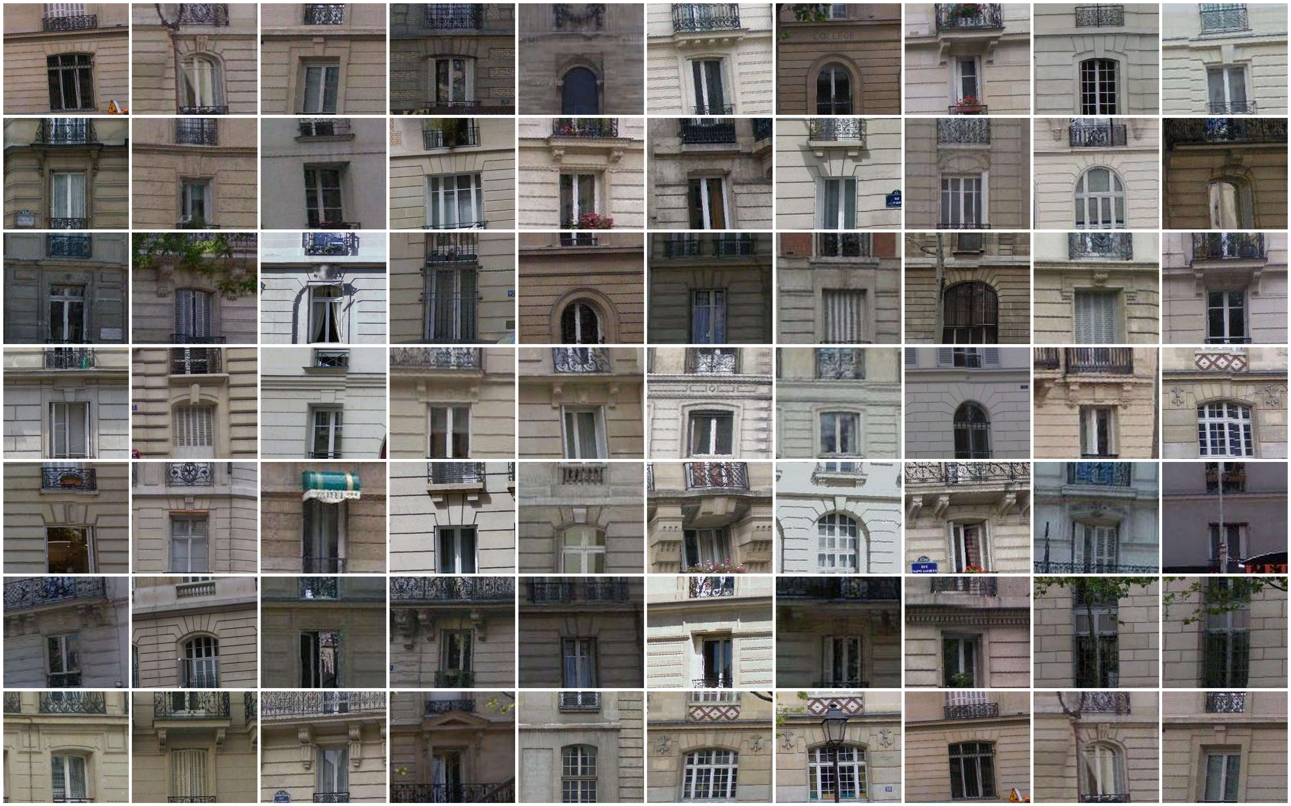
and gather in clusters discriminative from an given area
(e.g. Paris vs. other cities)

Slide 7
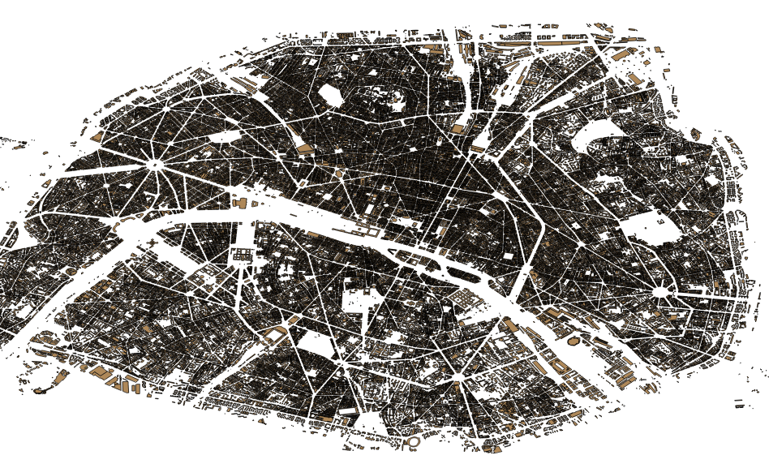
We recently combined the results with the cadaster of Paris containing 128k buildings

Slide 8
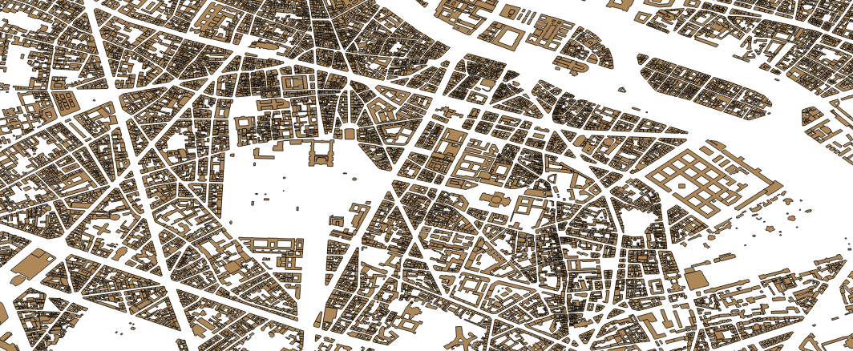
We recently combined the results with the cadaster of Paris containing 128k buildings

Slide 9
We recently combined the results with the cadaster of Paris containing 128k buildings

Slide 10
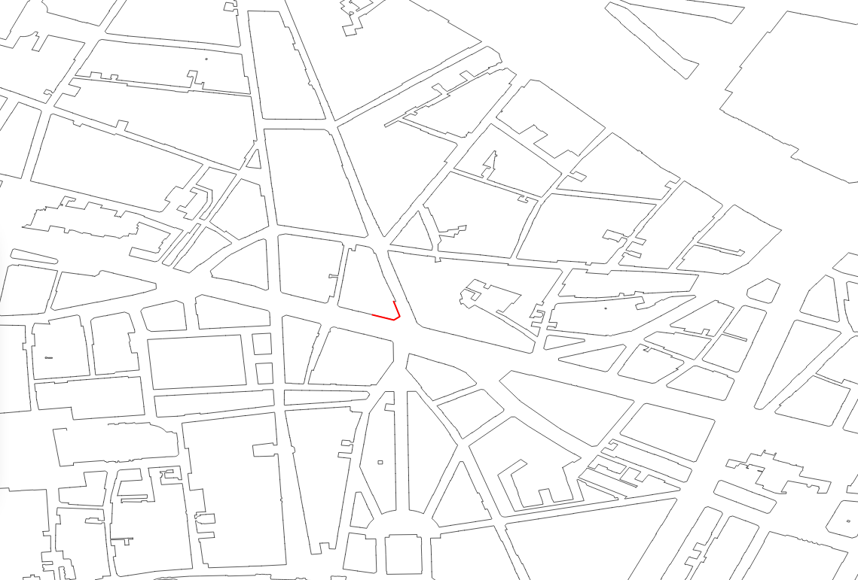
that we simplified to get only (115k) exterior facades
facade of the same building
Notes:
some official buildings don’t have any facade visible from the street

Slide 11
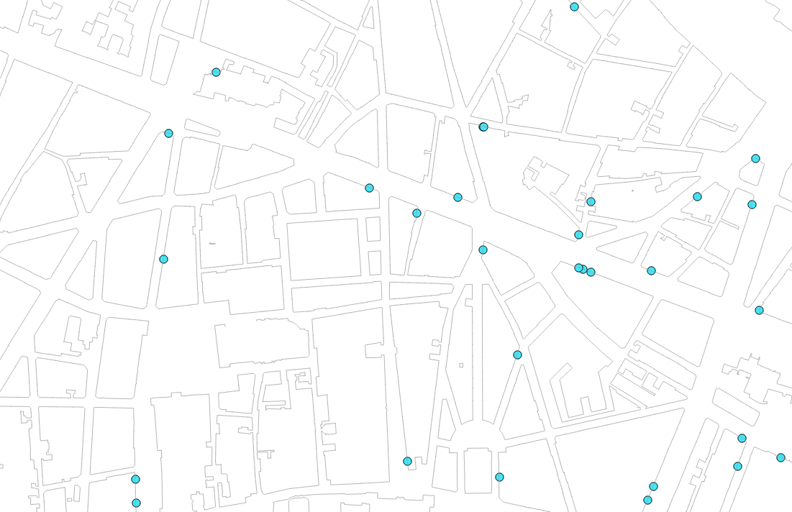
We can then project each visual element to a building and associate its cadaster metadata
Notes:
Because each visual element is part of a geolocated image, we are able to geolocate them.

Slide 12
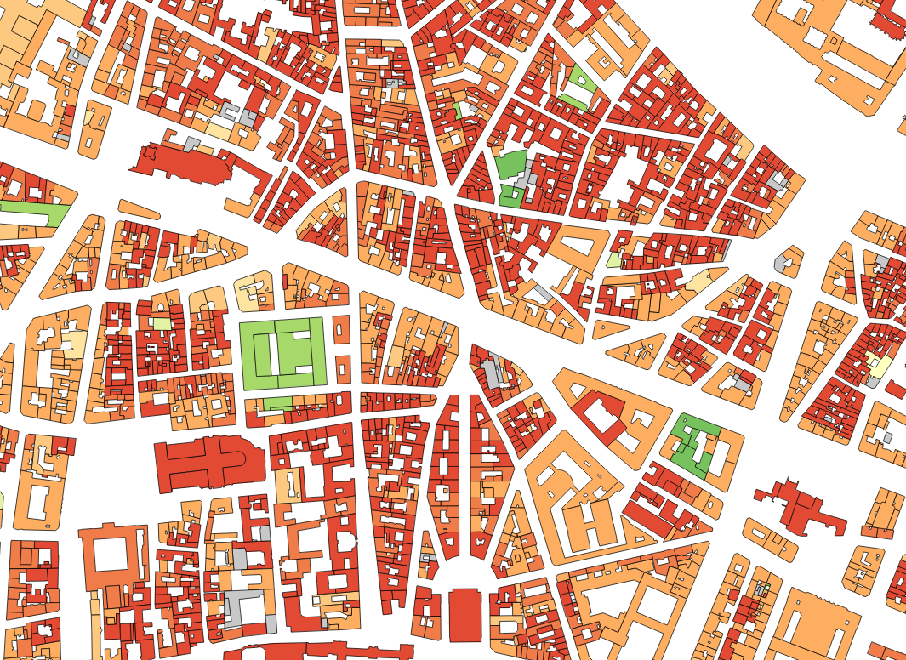
like its period of construction
< 1800
1801-1850
1851-1914
1915-1939
1940-1967
1968-1975
1976-1981
1982-1989
1990-1999
2000 >=
unknown

Slide 13
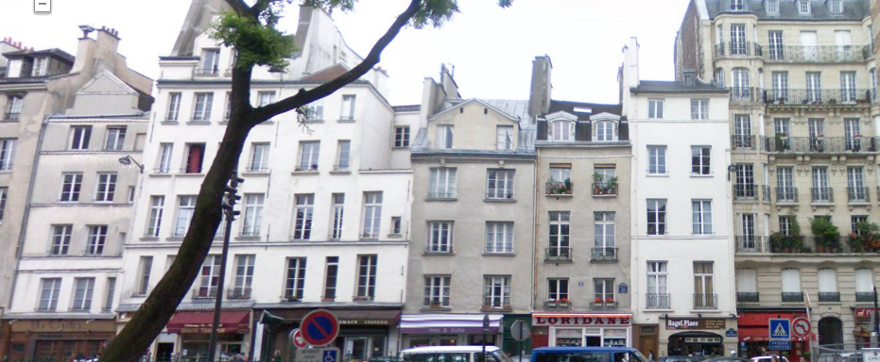
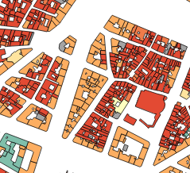
Period <1800
Period 1851-1914

Slide 14
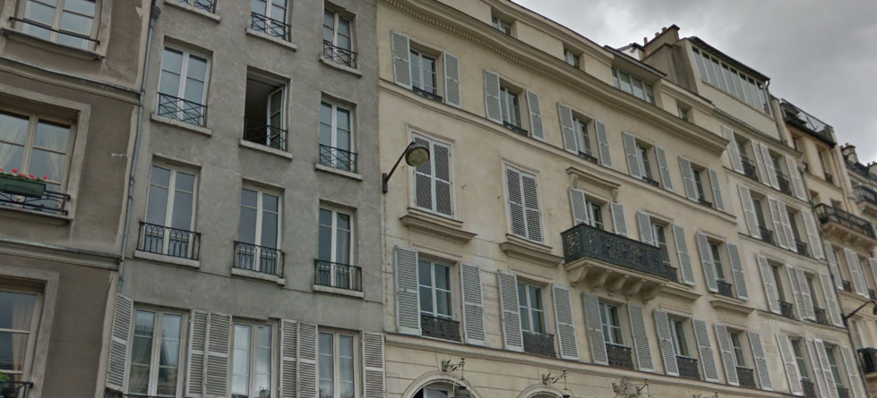
Period <1800
Period 1801-1850

Slide 15
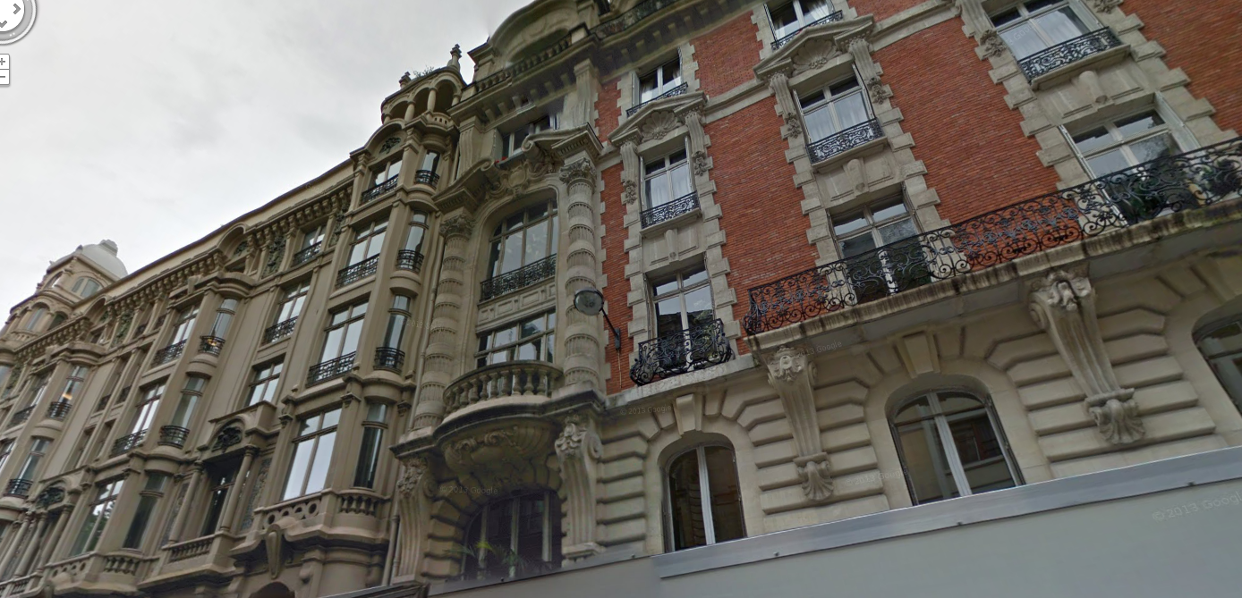
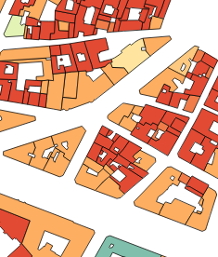
Period 1915-1939
Period 1851-1914

Slide 16
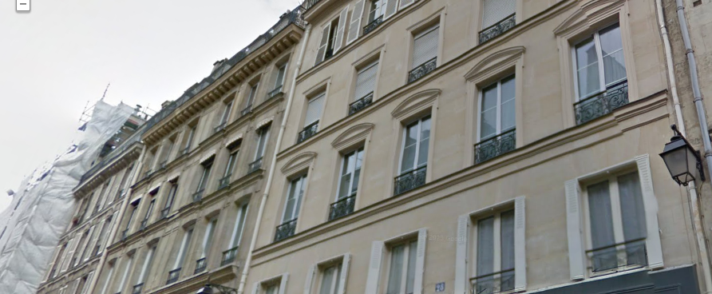
Period 1851-1914

Slide 17
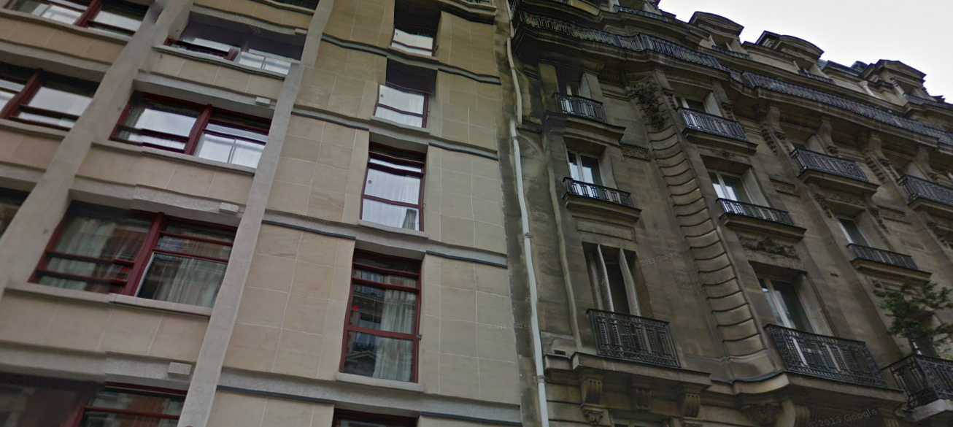
Period 1940-1967
Period 1851-1914

Slide 18
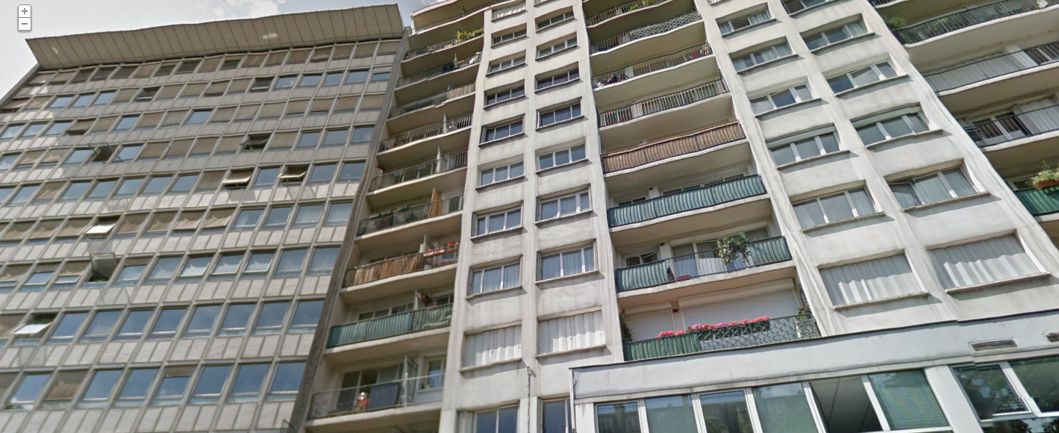
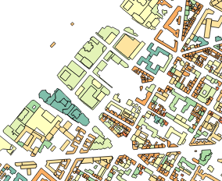
Period 1940-1967

Slide 19
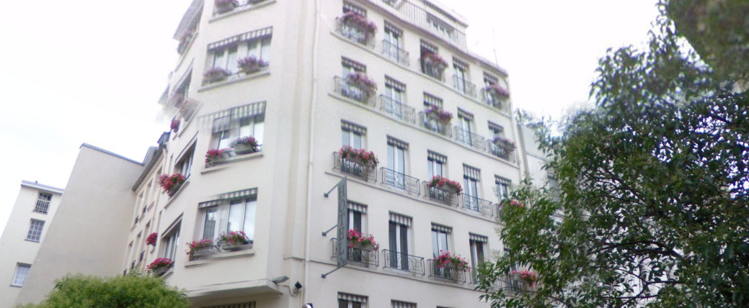
Period 1968-1975

Slide 20
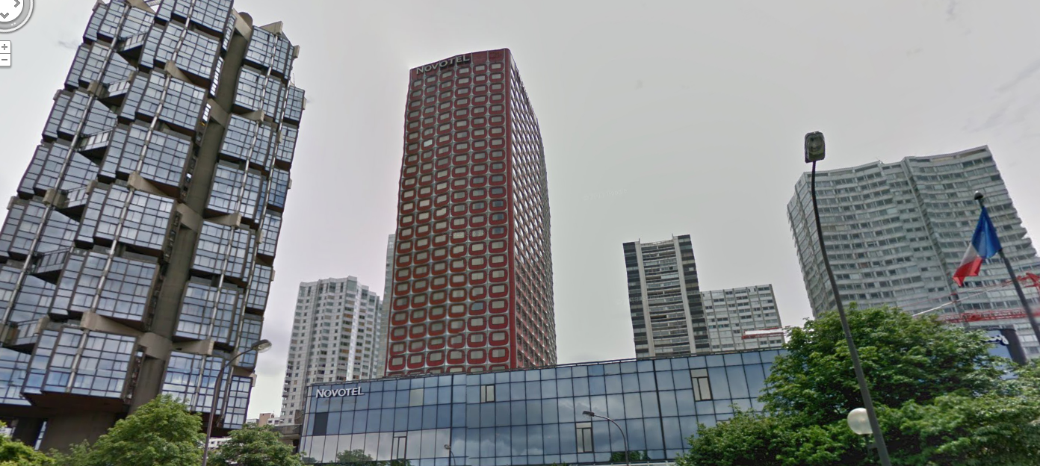
Period 1976-1981

Slide 21
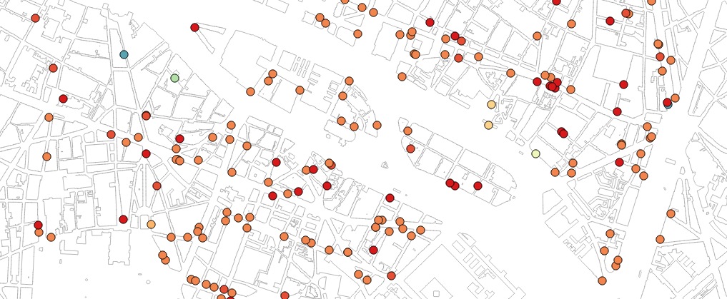
to produce spatial + temporal distribution of a cluster
< 1800
1801-1850
1851-1914
1915-1939
1940-1967
1968-1975
1976-1981
1982-1989
1990-1999
2000 >=
unknown
sample in the cluster

Slide 22
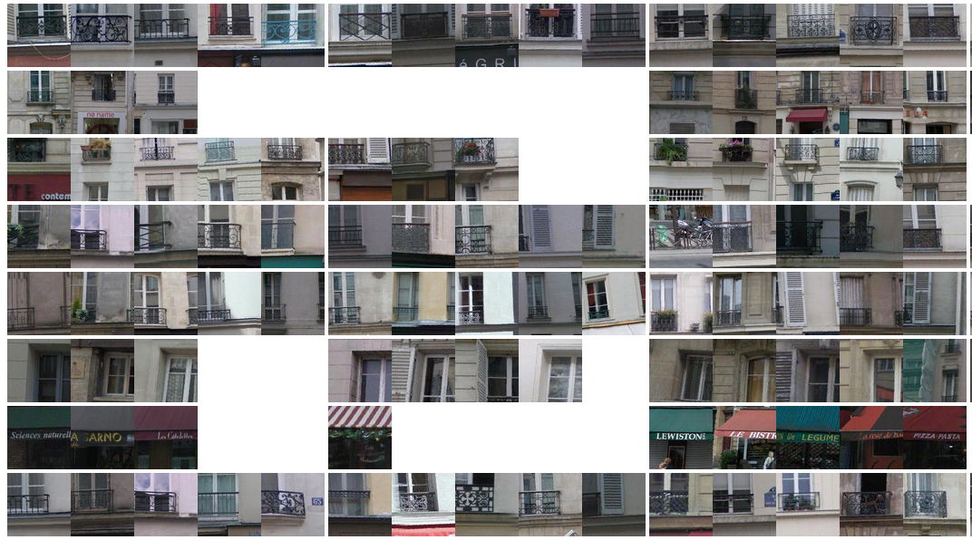
but discriminating visually elements by period of time is hard
<= 1800
1801 - 1850
1915 - 1939
1 cell = 4 samples max from a given cluster (row) and at a given period of time (column)
Notes:
1 row = 1 cluster , 1 column = 1 period of time,
1 cell = 4 sample from a given cluster (row) and at a given period of time (column)

Slide 23
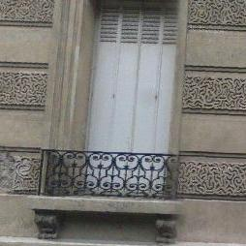
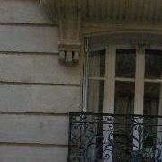
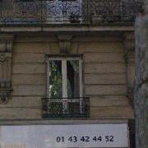
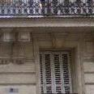
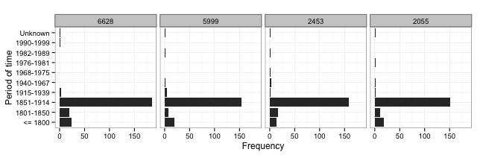
However some clusters are typical of a period of time
Histograms of clusters according to each period of time

Slide 24
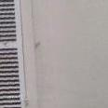
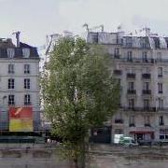

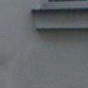
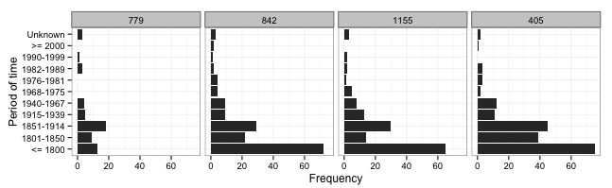
and some survived along several periods

Slide 26
Several issues remain
We use the results from [1] which is a small sample (only 5k - <4% from the 128K GSV images in Paris)
Visual elements are not architectural elements
[1] generates lots of meaningless and repetitive clusters from an architectural point of view (e.g. cluster of a corner of door, or just a part of a balcony, or clusters of exactly 4 windows).
Need to inject the knowledge of architects to produce semantically more meaningful clusters i.e. more aligned with an architectural representation of the visual world
Notes:
+ biased sample : sample from a small area in the center of Paris vs. random sampling in the whole Paris

Slide 27
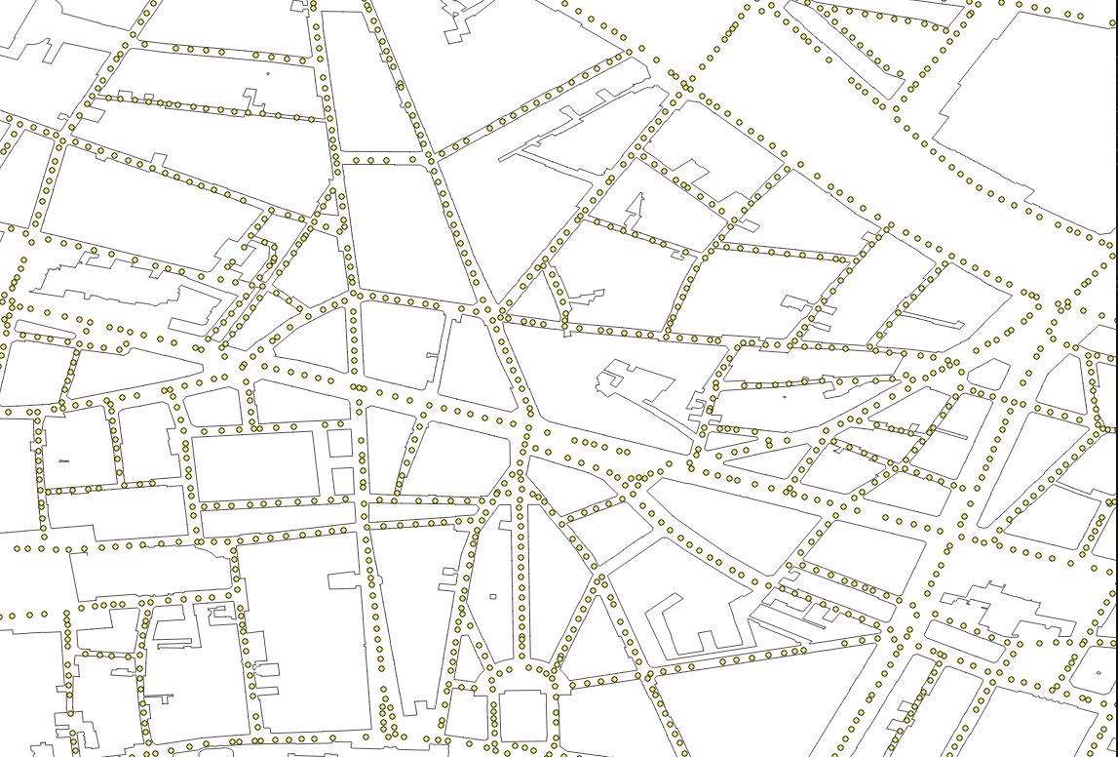
128K Google Street View images of Paris

Slide 28
128K Google Street View images in Paris

